Slide 1


SeptemberOctober
2025​
HFR Newsletter
In This Issue | HFR Indices & Data | HFR Media
Guest Analysis: I Came for the Arbitrage but Stayed for the Technology How Can HFR Power Your Investment Decisions? Hedge Fund Launches Accelerate & Liquidations Fall in 2025H1 | HFR is Hedgeweek’s Index Provider of the Year 2025 Watch latest HFRX Indices Performance Snapshot | HFR Podcast: A Blockchain Backbone for China
HFR is Hedgeweek’s Index Provider of the Year 2025
HFR has received the Hedgeweek Index Provider of the Year 2025 award, reflecting our leadership in delivering innovative, reliable benchmarks that support strategic investment decisions. In addition to producing over 500 Indices, HFR offers customized benchmarking to serve as an independent gauge of nuanced investment strategies.
HFR Indices are widely used to assess risk, underpin portfolio performance evaluation, and support fund marketing for major financial institutions and portfolio managers worldwide.
Our indices are aligned with industry best practices and meet top regulatory standards: HFR Indices are IOSCO-compliant, investable, and ESMA-registered. HFR Indices also meet the CFA Institute's definition of a valid benchmark, ensuring that performance data is transparent and methodologies are clear.
Our Indices are widely used in analytic modeling, client reporting, fund marketing materials, investor communications, and internal assessments. Index licenses are versatile and customized for individual client use cases.
HFR continues to exemplify the institutional standard, empowering the global financial community with trusted data solutions for informed investment strategies. Learn more about our Indices and see recent performance at hfr.com/indices.
September/October 2025 | HFR Media. All Rights Reserved | www.hfr.com
Read last month’s newsletter

Slide 2

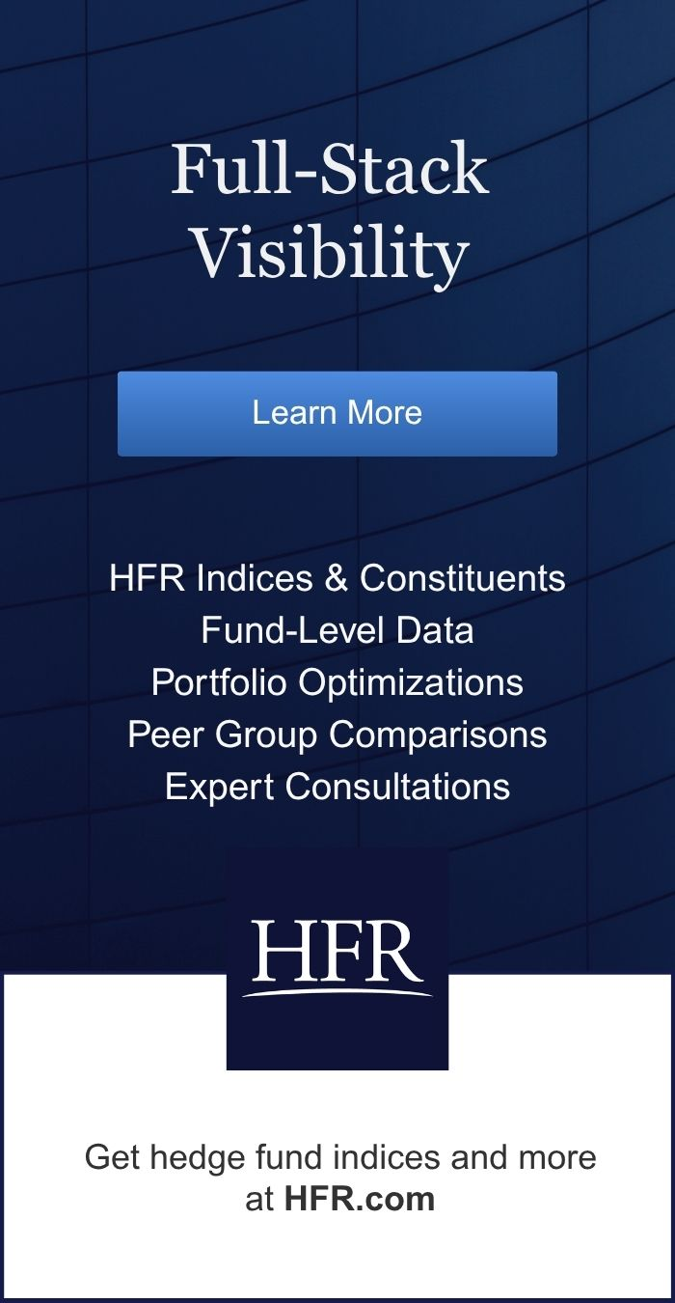
2
HFR Newsletter September/October 2025
2025 HFR MEDIA. All rights reserved.
Opinion: I Came for the Arbitrage but Stayed for the Technology
by Chris Solarz
After conducting due diligence on thousands of hedge funds over the past 20 years, I’ve been trained to be skeptical. I’m skeptical of the repeatability of alpha, overconfident portfolio managers, underconfident portfolio managers, back-tested or non-audited track records, non LP-friendly fee structures, conflicts of interest, asset/liability liquidity mismatches, and cherry-picked benchmarks, to name a few. I was very skeptical when I first reviewed digital assets funds in 2017.
Despite all that, I couldn’t deny the outsized, uncorrelated returns. In the early days, crypto hedge funds generated triple-digit returns through simple cross-exchange arbitrage. Bitcoin often traded at wildly different prices across exchanges, and the trade was to buy low on one and sell high on another. The real risk wasn’t the trade itself but whether the exchange would let you withdraw your capital.
It took years before I was convinced that blockchain technology was more than a casino but a cheaper, faster, and more transparent solution to our legacy systems. My eureka moment arrived while running with a friend in Central Park, who explained the Fat Protocol Thesis. When I transitioned my role as an institutional hedge fund allocator to a digital assets CIO in 2022, I joked that I came for the arbitrage but stayed for the technology.
The triple-digit heyday of Liquid Market Neutral strategies is over, but healthy double-digit returns remain. More importantly, the range of trading strategies has expanded: funding rate trades between perpetual swaps and spot, statistical arbitrage mean reversion spreads, volatility harvesting with options, and a growing universe of DeFi lending, staking, and incentive programs.
Crypto still demands extreme skepticism. Operational due diligence is as important as investment due diligence, and custody, counterparty risk, exchange risk, smart contract risks, and liquidity management are of paramount importance. Just as critical is diligence on the managers themselves to identify trustworthy partners that combine integrity and discipline.
Ironically, many institutional allocators use skepticism as an excuse for inaction. But you don’t need to believe that Bitcoin and Ethereum are “going to the moon” to see the alpha opportunity. A cottage industry of liquid, alpha-rich delta-neutral trading strategies has emerged, and the inefficiencies that birthed traditional hedge funds in the 1990s are alive and well in digital assets today.
Chris Solarz, CFA, CPA, CAIA is the CIO of Amitis Capital Digital Assets, a digital assets fund of funds. He welcomes comments and questions at csolarz@amitiscapital.com. All opinions expressed are the author’s own and do not constitute investment advice.
Chris Solarz
“A cottage industry of liquid, alpha-rich delta-neutral trading strategies has emerged, and the inefficiencies that birthed traditional hedge funds in the 1990s are alive and well in digital assets today.”
Read last month’s newsletter

Slide 3
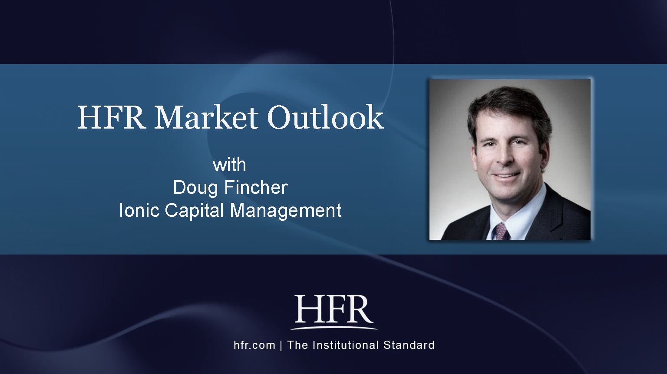
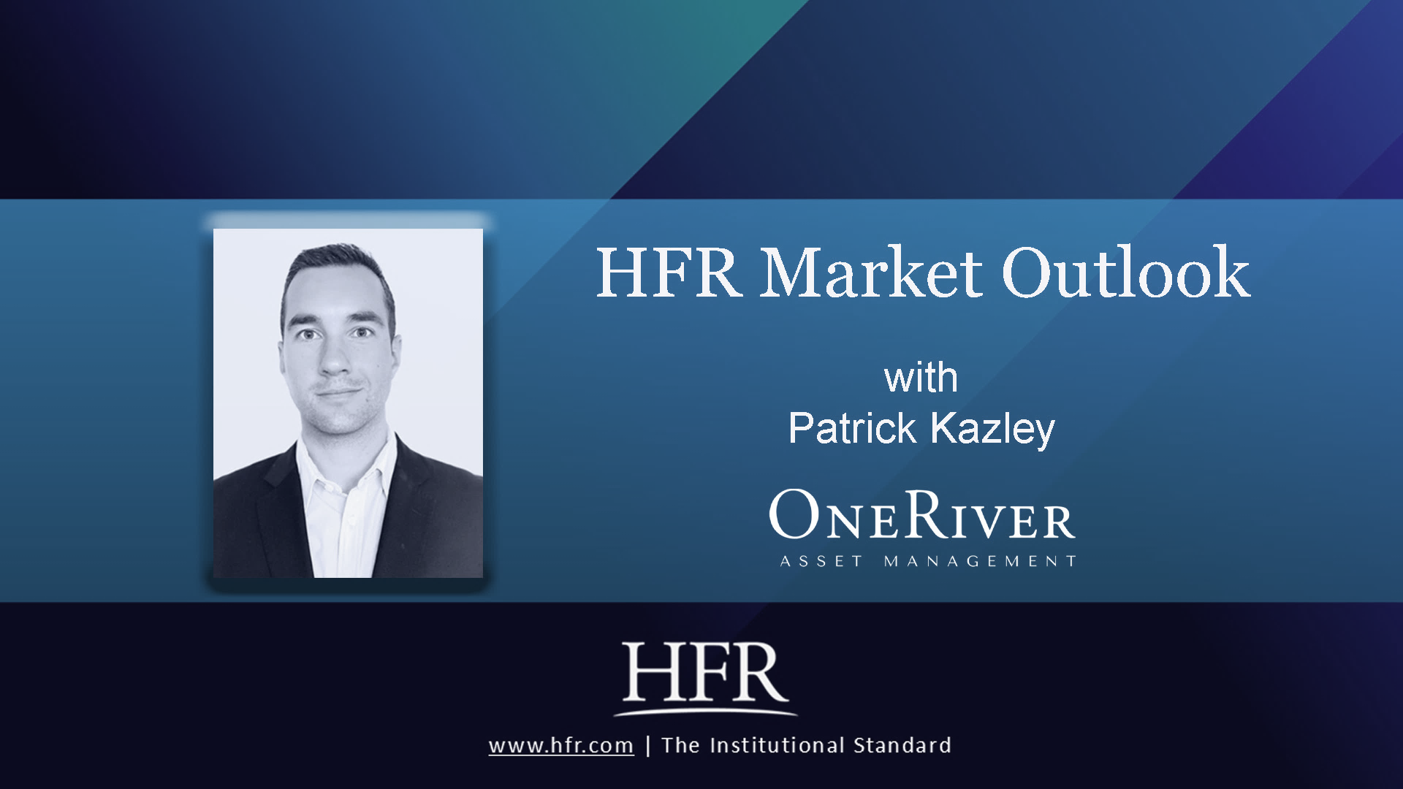
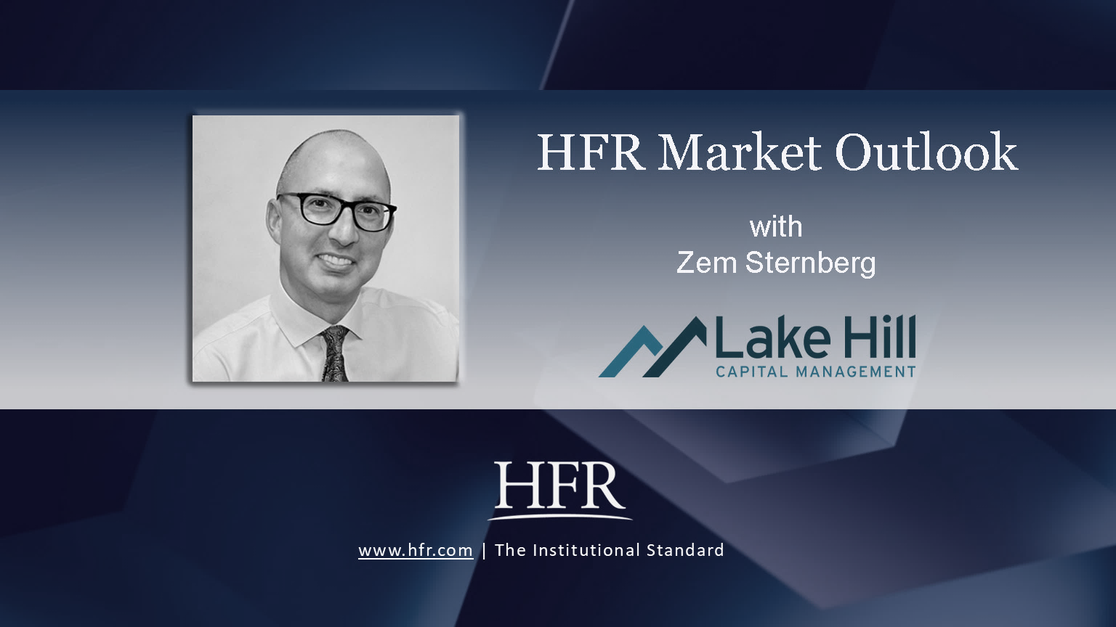
3
HFR Newsletter September/October 2025
2025 HFR MEDIA. All rights reserved.
HFR Podcast : A Blockchain Backbone for China
By Dr. S. Aneeqa Aqeel
In 2019, the Communist Party of China called a Politburo study session to investigate blockchain technology. China’s President Xi Jinping declared blockchain a foundational building block for innovation and Chinese economic growth. As China wraps up its 14th five-year economic plan in 2025, Chinese companies boast the greatest number of blockchain patents across the globe, propelled by the strategic goals set by top leadership.
You may recall China’s precocious lead in cryptocurrency mining and its famous mining farms. Only specialists kept tabs on the subsequent ban of all crypto activities in 2013. Under established property law, Chinese courts still allow individuals to own crypto but forbid its use or trade inside China. Institutions, meanwhile, are barred from engaging with crypto altogether. Even though China eschews its primacy application in cryptocurrency, blockchain is powering China’s e-commerce platforms. Large, well-established companies like Alibaba and Ant Finance, as well as small no-name enterprises have all developed their own versions of blockchain and associated applications.
The U.S. Genius Act passed into law in July of this year has opened the door to a new type of digital currency, one that is fortified by a U.S. peg of sorts. While the rest of the world has scrambled to develop an immediate response, China’s reaction has been one of caution both internally and externally. Most importantly, China does not see U.S. stablecoins as a desirable asset to hold, as compared to say dollar-fortified commercial paper. Its primary concern remains with not diluting state authority and visibility over financial flows.
This is not to say that their curiosity is not piqued: China has launched a controlled ‘offshore’ stablecoin experiment in Hong Kong, as there is local appetite for a renminbi-backed stablecoin.
These insights and a lot more detail can be gleaned from my conversation with Dr. Zongyuan Zoe Liu of the Council of Foreign Relations on the HFR Podcast. We discuss China’s digital economy, its financial system, political structures, and the expansion of its sovereign wealth fund. A foremost expert in her field, and advisor to the U.S. government, Dr. Liu’s wealth of knowledge is clear and deeply informative. Click for the HFR Podcast Part 1 episode and stay tuned for Part 2 coming up next month!
You can find all episodes of the HFR Podcast from our website, and on our YouTube and Spotify channels. Please reach out to hfrmedia@hfr.com with questions.
How Can HFR Power Your Investment Decisions?
HFR is recognized as the world’s leading benchmark and hedge fund index provider. These benchmarks power strategic decision-making for institutional investors, family offices, and sovereign wealth funds.
HFR Database also allows investors to take a closer look at individual funds, evaluate performance, and conduct customized portfolio optimization.
Using HFR’s extensive cross-section of the industry, asset managers can conduct in-depth peer analysis and forecast portfolio performance in the HFR Database: Database@hfr.com
In the Market Outlook series featured on the left, three top performing managers in the HFR Long Volatility Index family discuss their strategic approach to long volatility, convexity, and market sentiment indices.
Click on the thumbnails to watch HFR Market Outlook interviews (4 - 7 minutes long), available only to accredited investors. To connect with these managers, contact us at hfrmedia@hfr.com
Read last month’s newsletter

Slide 4

4
HFR Newsletter September/October 2025
2025 HFR MEDIA. All rights reserved.
Hedge Fund Launches Accelerate & Liquidations Fall in 2025H1
HFR Market Microstructure Report
2025 has seen an acceleration in M&A activity as well as investment in AI enterprise. The hedge fund industry is riding the wave, with new launches accelerating in the third quarter and liquidations at historic lows. Moreover, HFR data estimates show a total of $4.74 trillion under management by the hedge fund industry, a record high level.
HFR’s analysis of market microstructure records 141 new funds launched in 2Q25, bringing the first half total for this year to 262. This is on pace to surpass the estimated 479 launches in 2024, which was the highest annual total since 2021.
HFR’s Microstructure Report also reveals that liquidations have been at historical lows in 2025. Compared to 406 fund liquidations in 2024, we estimate only 65 liquidations in the first half of this year.
For more detail on fund performance dispersion across strategies, fee structures, as well as industry service providers, please access the HFR Market Microstructure Report on the HFR website.
Stay in touch!
If someone shared the HFR Newsletter with you, please sign up to receive our updates.
Create a free account at HFR.com and select your communication preferences.
Email us at hfrmedia@hfr.com
Read last month’s newsletter

